Slide 1

FIRE FIGHTING ROBOT
GHOUSIA COLLEGE OF ENGINEERING Department of Mechanical Engineering RAMANAGARA-562159
Presented by:
Name of the student:
Vikas N (1GC17ME056)
Darshan B (1GC15ME016)
Syed Sahil (1GC16ME083)
Rakshith R (1GC16ME061)
Guided by:
Dr. Mohammad Aquil Ahmed
.

Slide 2
CONTENT
Introduction
Designing the Robot
Fire Fighting Robotic vehicle
Working principle of Fire Fighting Robot
Block Diagram
Hardware Requirements
Software Requirements
Advantages
Disadvantages
Applications
Conclusion

Slide 3
INTRODUCTION
It is designed to develop a firefighting robot using RF technology for remote operation.
Fire fighting is the act of extinguishing fires, i.e it sprinkles water on the fire.
The robotic vehicle is loaded with the water tanker and a pump which is controlled by wireless communication to throw water.
Arduino Uno microcontroller used for the desired operation.
A fire fighter suppresses and extinguishes fire to prevent loss of life and destruction of property and the environment.

Slide 4
DESIGNING THE ROBOT
The robot vehicle consist of the following units:
A rectangular base to support the whole robot structure, attached to two wheels for motion.
A couple of DC motors to provide required movement to the robot.
A control unit consisting of an RF receiver which receives command signals from a transmitter unit to control the engine driver and control the motors accordingly.
A metal detector circuit along with a buzzer alarm which triggered once the metal detector.

Slide 5
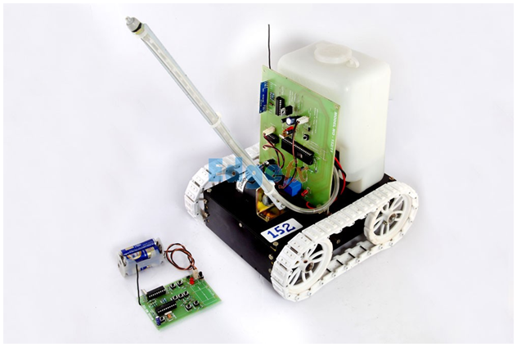
FIRE FIGHTING ROBOTIC VEHICLE

Slide 6
WORKING PRINCIPLE
The robot vehicle loaded with the water tanker.
The pump is controlled by wireless communication (RF and DTMF Mobile communication )
The transmitter end connected to the push buttons.
Using this pushbutton commands are sent to the receiver and control moment of the robot like forward, backward, left , right.
The receiving end three motors are connected to the microcontroller.

Slide 7
In the home, offices and industries the fire sensor are kept in certain places, when fire occurs near a fire detector.
The RF receiver integrated with a microcontroller. When the RF receives the signal that information is passing to the microcontroller, the robot is moved towards fire sensors.
Once the robot reaches the desired location, then the robot stops and activates the sprayer to that fire.
After firing the robot, goes to the initial position.

Slide 8
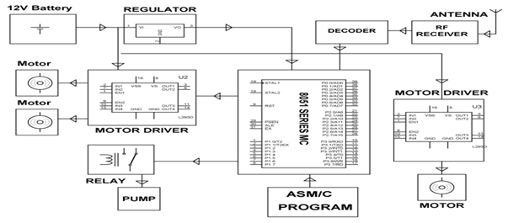
BLOCK DIAGRAM

Slide 9
HARDWARE REQUIREMENT
ARDUINO UNO MICROCONTROLLER
DTMF SIGNAL AND DECODER
FLAME SENSOR
MOTOR DRIVES
ENCODER
DC MOTORS
RELAY
ROBOT BODY WITH WATER TANK
CAPACITORS
DIODE
BATTERY
PUMP

Slide 10
SOFTWARE REQUIREMENT
Arduino IDE 1.6.7

Slide 11
ADVANTAGES
Capability of sensing accurately with increased flexibility
No line of sight Not blocked by common materials.
It can pass through solids Longer range
Not sensitive to light
Not sensitive to weather conditions

Slide 12
DISADVANTAGES
Communication devices mostly use similar frequency, so interference occurs if the address are not specified.
High cost.
Data rate transmission is lower than wired transmission.
It cannot be work beyond the limit Fire

Slide 13
APPLICATIONS
Can be used in server room .
Extinguishes fire where probability of explosion is high.
Usable in power plant control rooms, captain bridges, flight control centers.
Disaster area monitoring and rescue.

Slide 14
CONCLUSION
In conclusion, our approach of modular design strategy was a good solution in implementing the fire fighting robot as it easier for individual to work on their tasks independently. The extensive use of the microcontroller ensured the integration steps to be simpler.
Therefore, our model of the robot can successfully find “fire” and reach it without running into obstacles also we managed to construct the robot comfortably within the budget of $400
Throughout the project, our technical knowledge was put to practical use and hence learnt many technical skills.

Slide 15
REFERENCES
Custom Computer Service (CCS) Inc. (2006). Development Kit for the PIC MCU Exercise book: PIC16F877A.
Eltec Pyroelectric detector. (2009). Acroname Robotics. Retrieved 1st April, 2009 from http://www.acroname.com/robotics/parts/R1-442-3.html
Microchip Technology Inc. (2001). PIC 16F87X Datasheet.
OSRAM. (2005). Silicon NPN Transistor (SFH309 PFA) Datasheet. Published by OSRAM Opto Semiconductors GmbH.
RS New Zealand. (n.d.). Retrieved March 26th 2009, from http://newzealand.rs-online.com/web/home.html
Sharp Corporation. (2006). GP2D120 Optoelectronic device datasheet.
(2009). Video of our robot. Retrieve from http://jamesyxu.com/Robot%20Final.zip
Sharp IR Rangers Information. (2008). Acroname Robotics. Retrieved 18th May, 2009 from http://www.acroname.com/robotics/info/articles/sharp/sharp.html#e8
UVTron Flame detector. (2008). Acroname Robotics. Retrieved 1st April, 2009 from http://www.acroname.com/robotics/parts/R66-R2868.html

Slide 16
THANK YOU

